Slide 1
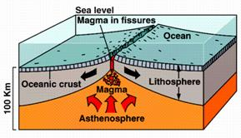
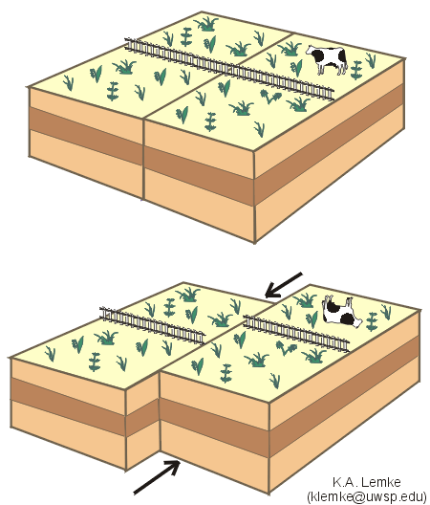
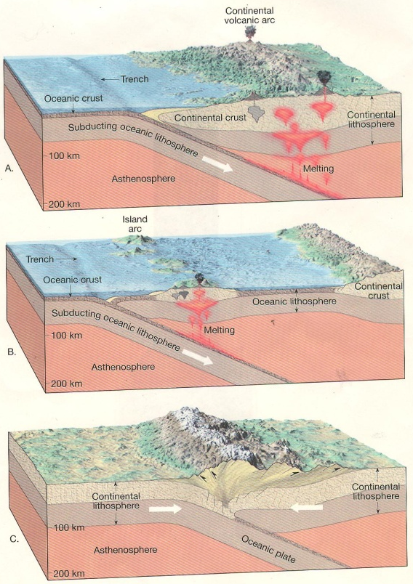
Plate Tectonics in Motion
Purpose: The purpose of this activity is to replicate the force and motion of Earth’s plates during tectonic movement.
Teacher Prep Materials List: (Per 2 students) 10 minutes
1 chocolate pudding cup
2 spoons
1 graham cracker (carefully break in half, then break in half again)
2 sheets Wax paper (12cm by 12 cm)
Teacher Background Information:
Earth’s crust is broken into many large and small pieces called plates and come together along plate boundaries. Tectonic movement is caused by the shifting of these plates due to great amounts of heat and pressure driven by convection currents in the magma. There are three types of plate boundaries: divergent, convergent and lateral/transform.
Divergent boundaries occur where two plates move apart creating new ocean floor. These boundaries occur along mid-oceanic ridges on oceanic plates and create rift valleys on continental plates. Examples include the Mid-Atlantic Ridge and the African Rift Valley.
Transform/Lateral boundaries occur where two plates are moving past each other horizontally creating earthquakes along fault lines due to the constant force of friction. An example is the San Andreas Fault.
Convergent boundaries occur where two plates are crashing into each other. There are three types of convergent boundaries: continental-continental, oceanic-continental, and oceanic-oceanic. Continental-Continental boundaries occur where two continental plates crash into each other along subduction zones (the less dense plate will slide underneath the more dense plate) creating trenches and mountain chains. Examples include the Himalayan and Rocky Mountains. Oceanic-Continental boundaries occur where one oceanic plate crashes into a continental plate causing the less dense oceanic plate to subduct underneath the continental plate creating trenches and volcanic mountains. Examples include the Andes and Sierra Mountain chains. Oceanic-Oceanic boundaries occur where two oceanic plates crash into each other causing the less dense plate to subduct underneath the other plate causing trenches and volcanic island arcs. Examples include the Aleutian and Hawaiian Island chains.
A Divergent Boundary
A Transform/Lateral Boundary
Convergent Boundaries

Slide 2
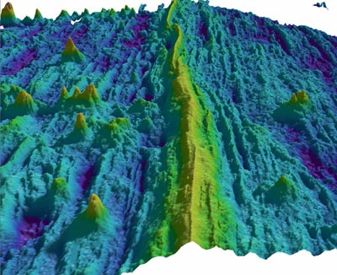
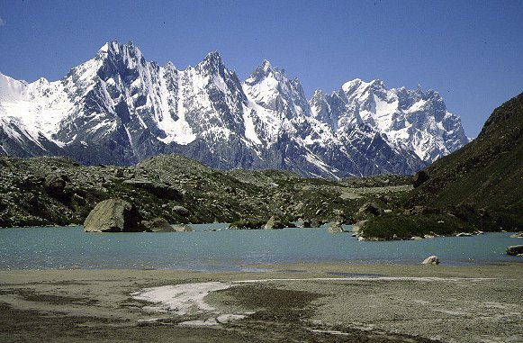
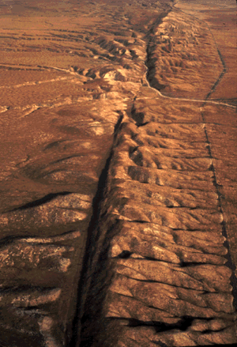
Student Page
Plate Tectonics in Motion
Procedures:
Have students split the pudding between them. Spoon out pudding and drop it onto the middle of the wax paper. DO NOT SPREAD IT OUT.
Place the 2 quarter half pieces of graham cracker on top of the pudding. Align them along the broken edges . It should look like one piece.
Read and follow directions for student procedures.
Student Procedures
Student Observations
Actual Diagrams
Divergent Boundary:
Use two fingers from each hand to act as heat and pressure.
While applying pressure down, move the plates apart about 10 cm.
Draw your observations in the box to the right.
Compare your drawing to the actual picture of a divergent boundary.
Convergent Boundary:
Use two fingers from each hand to act as heat and pressure.
While applying pressure down, quickly crash the plates back together hard.
Draw your observations in the box to the right.
Compare your drawing to the actual picture of a convergent boundary.
Transform / Lateral Boundary:
Use two fingers from each hand to act as heat and pressure.
While applying pressure down, move the plates together while moving them back and forth very quickly. Breaking is normal and models the breaking of Earth’s crust (earthquake).
Draw your observations in the box to the right.
Compare your drawing to the actual picture of a transform boundary

